Slide 1

Introducton to DevOPs

Slide 2
OUR Topics
Why We need DevOps and What is DevOps
Setting up our Tool Set
Python (and why we’re learning it in a dev ops course)
Source Code Management
Continuous Integration
Continuous Delivery
Virtualization
Configuration Management (ansible, puppet, chef, terraform)
Containerization (Docker )
Cloud Computing (AWS, Azure, Google Cloud Platform)
Continuous Monitoring (Nagios, AWS Cloudwatch, Splunk)
Final Project
DevOps for 2020 (new tools / topics in the dev ops pipeline)

Slide 3
What is DevOps
Software Development in the 1990’s
Programmers would write software (mainly in c and c++) and then manually share it with users on servers.
Users would download that software and manually install it on their computers.
People that wrote the software were generally seperated from the people that maintained the servers for running the software on.
Bringing software to market was a long, arduous task filled with complicated and error prone steps, resulting in a long development lifecycle.

Slide 4
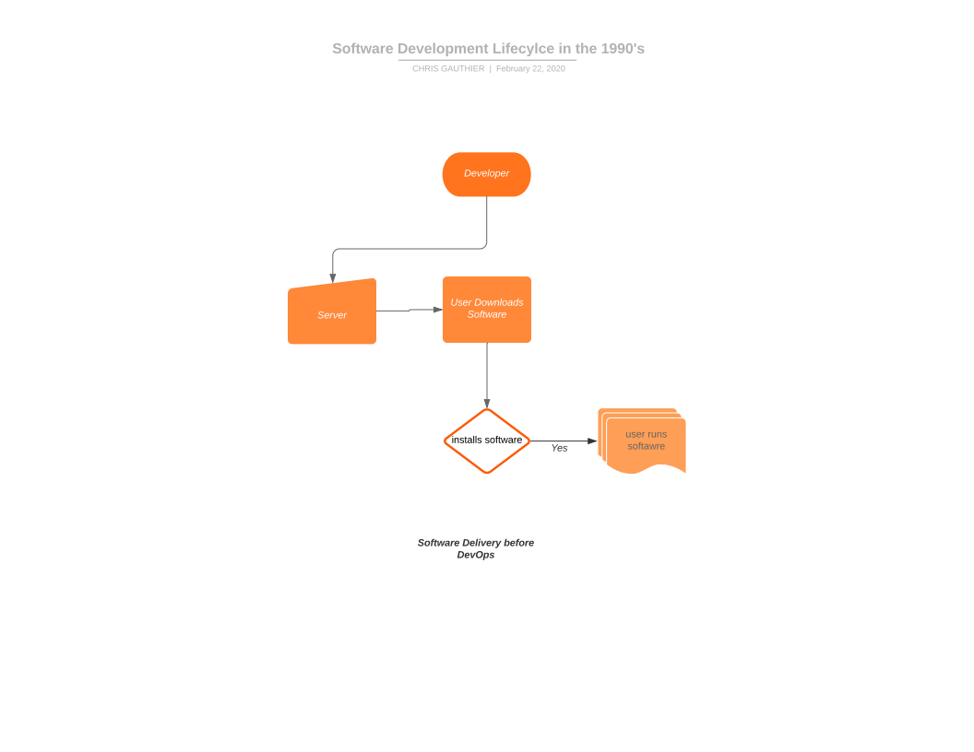
What is DevOps

Slide 5
What is DevOps
Why this is bad:
Manually creating software and manually installing software introduces a lot of manual errors into the process.
Separating the process of bringing software to market into two isolated teams tends to create animosity and “its your fault not mine” type of behaviour.
With this paradigm, software takes a long time to be delivered and another company that is faster and better will drive you out of the market.

Slide 6
What is DevOps
What is DevOps:
The introduction of the DevOps practice brought about a merging of the Development Team and the Operations Team into a position called “DevOps”.
Working together, these teams create a synergy that makes working in a software company a pleasure rather than a stressful ordeal.
From Wikipedia:
Devops is a set of practices that combines software development and information-technology operations which aims to shorten the systems development life cycle and provide to shorten the systems development cycle and provide continuous delivery with high software quality.

Slide 7
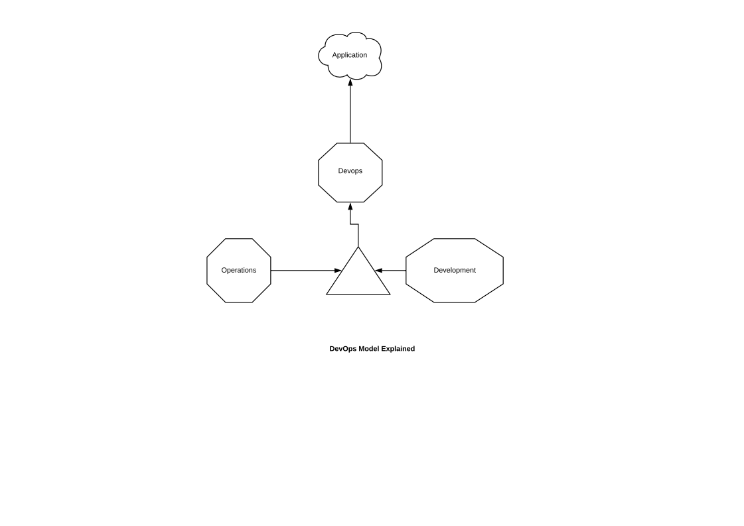
What is DevOps

Slide 8
What is DevOps
Resources:
Intro to dev ops
https://www.youtube.com/watch?v=_Gpe1Zn-1fE
What does a dev ops engineer do?
https://www.youtube.com/watch?v=o_sUNqZtfVQ

Slide 9
Installing Our Stack
The tools we will be using in this course:
There will be a handout that goes through the steps of creating the environment we need for this course. Please make sure you read through and install all the software on that list.
We will be installing:
1) Virtual Box
2) Ubuntu Linux 19.04
3) Python
4) Docker
5) Jenkins
6) Ansible
See the desktop stack setup in the git repo for this course to find out how to do this: Dev Ops Course - Desktop Setup.pptx:
https://github.com/chrisgauthier742018/devopscourse

Slide 10
Source CODE Management GIT
Source Code Management (SCM) is one of the most important concepts in a DevOps course.
This practice stores our source code in buckets on a remote server that can be accessed from our local workstations.

Slide 11
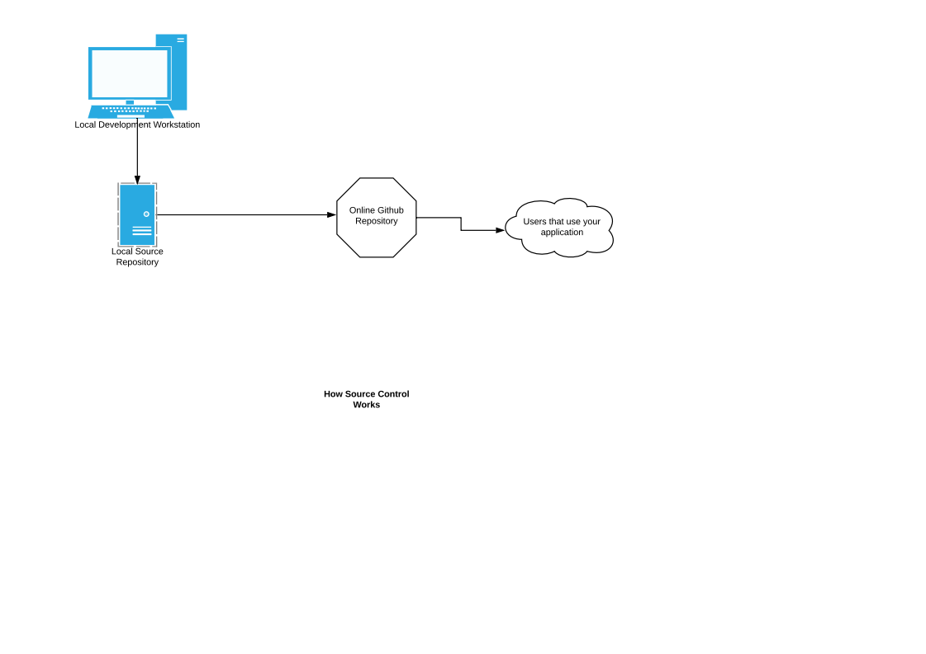
Source CODE Managment GIT

Slide 12
Source CODE Management GIT
What is SCM:
When developing a software application, SCM gives us the following essential features:
1) Backup and Restore
A SCM solution allows us to move between versions easily.
For example, if we make a mistake in our code, we can simply go back to a working version and start work again.
2) We can track our changes on a project by commit. This
allows us to track who changed the code and what was changed. This is useful to know who does what on a project.

Slide 13
Source CODE Management GIT
Resources:
https://www.youtube.com/watch?v=Klfjr4TF9i0
https://www.linuxnix.com/what-is-source-code-management-or-version-control/
https://www.youtube.com/watch?v=HVsySz-h9r4

Slide 14
Source CODE Management GIT
Demonstration (pulling a repo)
1) Open your Ubuntu virtual machine.
2) Git to download (clone) the python repo I’ve made
here: https://github.com/chrisgauthier742018/demopy.git
3) Make a change in the README.md file of the python project.
4) git status
5) git commit -m “Changed Readme”
6) git push -u orgin master

Slide 15
Source CODE Management GIT
Homework (creating and initing a repo)
1) Open your Ubuntu virtual machine.
2) create a helloworld.py application
3) recreate the steps required to create your repo on github.com
4) setup your helloworld.py app under source control.
5) push your app up to your own rep.

Slide 16
Continuous INTEGRATION
Before DevOps, we used to have the following scenario when there were more than one developers working on a code base.
Developer A would clone the source code and make changes. Developer B would clone the source code and make changes.
Developer A would commit those changes to the repos and Developer B would commit those changes to the repo.
Some times, if there is a mistake in one of the files being changed, Developer A and Developer B would have to sit down and figure out what broke and integrate fixes and then commit to a master branch again.
(chart depicting this here)

Slide 17
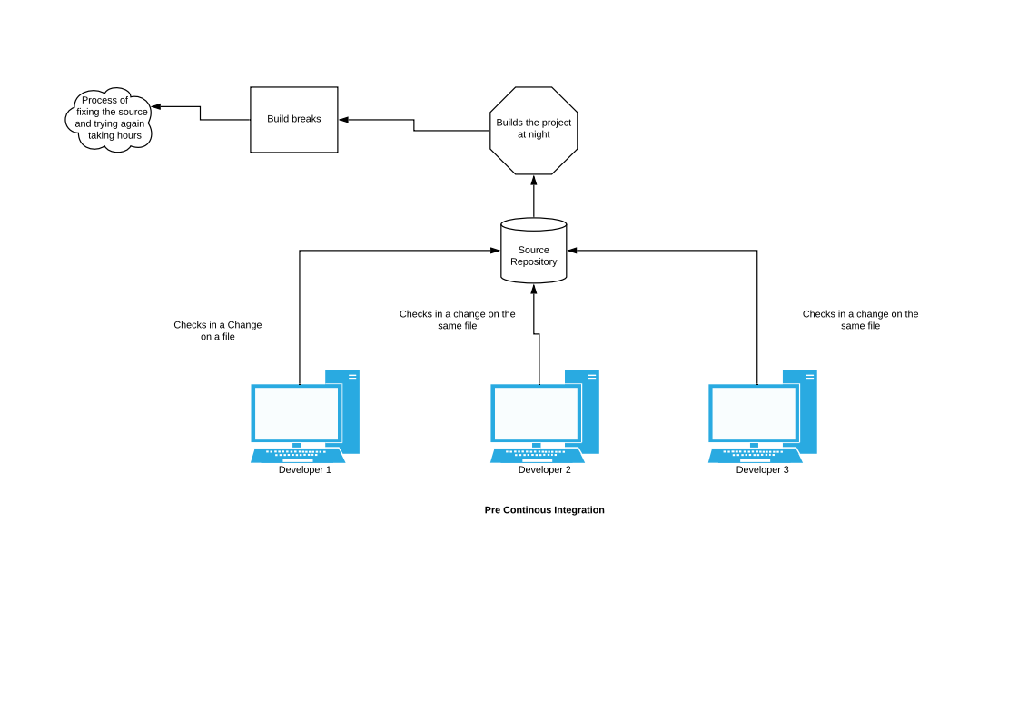
Continuous INTEGRATION

Slide 18
Continuous INTEGRATION
Now that DevOps is in the picture, there is something called a Build Tool that sits in the middle of the developers making changes to the code base.
Every time a developer will commit their changes to the source code base, the build tool notices there is a change and pulls the code base down, builds it and runs automatic tests on it. If the change is built and doesn’t have any errors, it will be pushed into production.

Slide 19
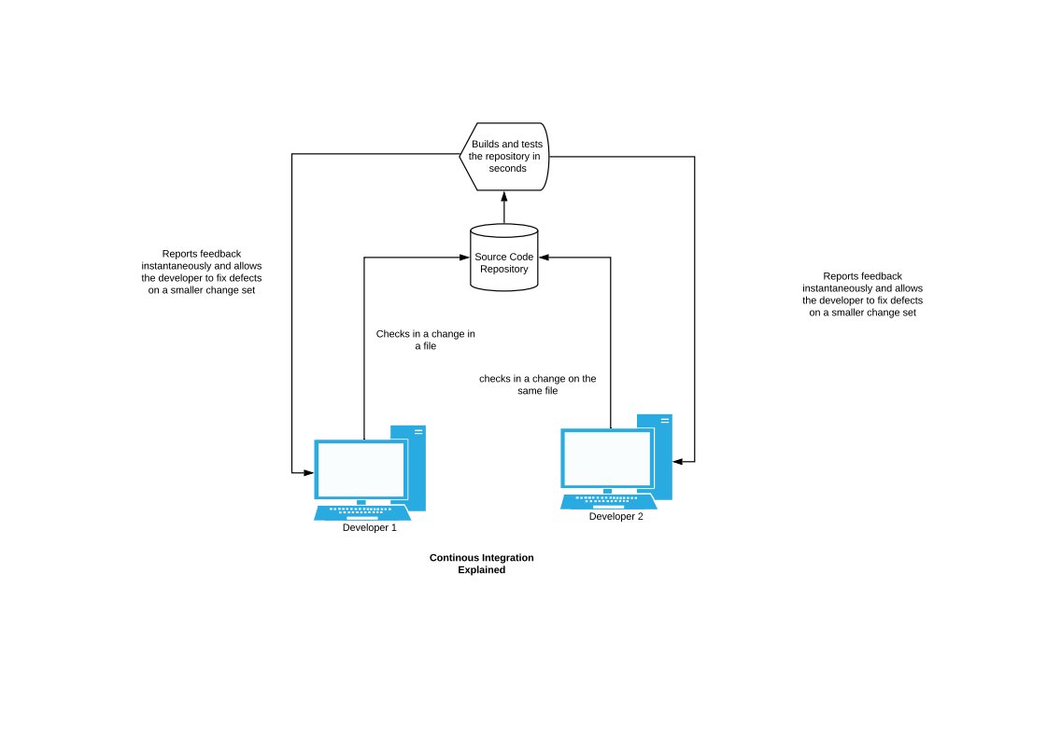
Continuous INTEGRATION
.

Slide 20
Continuous INTEGRATION
Martin Fowler defines Continuous Integration like this:
Continuous Integration is a software development practice where members of a team integrate their work frequently, usually each person integrates at least daily - leading to multiple integrations per day. Each integration is verified by an automated build (including test) to detect integration errors as quickly as possible. Many teams find that this approach leads to significantly reduced integration problems and allows a team to develop cohesive software more rapidly. This article is a quick overview of Continuous Integration summarizing the technique and its current usage.

Slide 21
Continuous INTEGRATION
Resources for continuous integration:
CI explained:
1) https://www.youtube.com/watch?v=1er2cjUq1UI
CI Example
1) https://www.youtube.com/watch?v=p7-U1_E_j3w&t=211s

Slide 22
Continuous INTEGRATION
Home work for this Section:
1) Review this link and configure the jenkins installation we setup in our tools setup section to build and test our application
You will need to download the python application we pushed up to your git repo earlier in the Source Code Management Section.
Copy that link into your clipboard. You will need it to setup jenkins to pull from this repository.
https://www.youtube.com/watch?v=yse_OrdueKk&t=978s

Slide 23
Continuous Delivery
What is Continous Delivery
Combined with Continous Integration, this process aids in the automated delivery of working, production ready software.
Once the code is automatically tested by the CI tool (jenkins), the tool will then automatically push the working code into production.
The users will then see the working software product with the new changes / feature sets in place.

Slide 24
Continuous Delivery
Resources:
1) https://www.youtube.com/watch?v=2TTU5BB-k9U
2) https://www.youtube.com/watch?v=Pv5hohD25ls

Slide 25
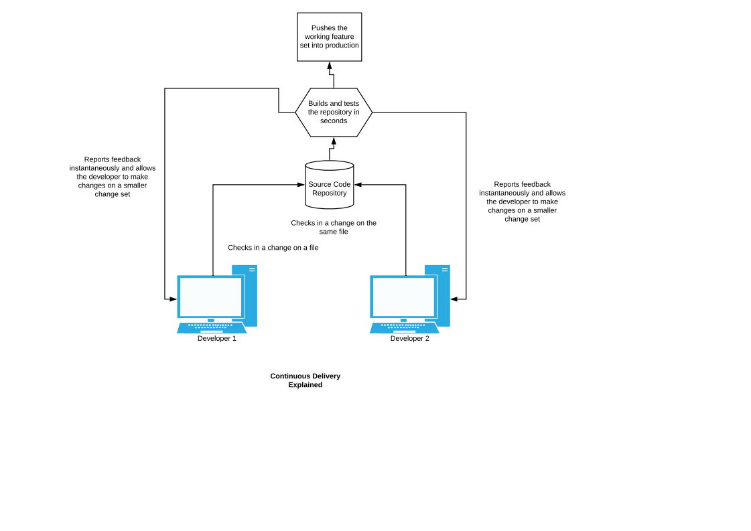
Continuous Delivery

Slide 26
Cloud Computing
Cloud Computing is the latest trend in software delivery. We will start with that cloud computing is and why we use it.
What is cloud computing:
Before cloud computing, all of our software ran on infrastructure that was hardware based. That means, server racks, network devices and a lot of other hardware that existed in a physical location you could access and handle manually.

Slide 27
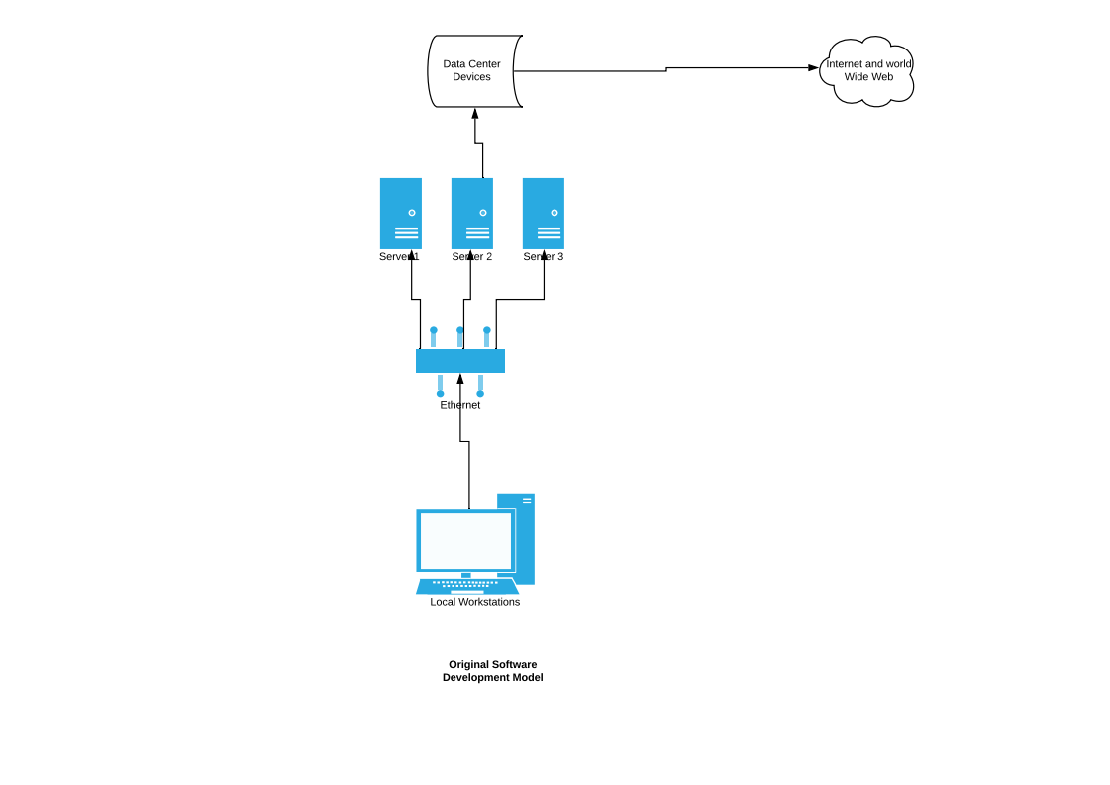
Cloud Computing

Slide 28
Cloud Computing
Cloud Computing is the latest trend in software delivery. We will start with that cloud computing is and why we use it.
What is cloud computing:
Before cloud computing, all of our software ran on infrastructure that was hardware based. That means, server racks, network devices and a lot of other hardware that existed in a physical location you could access and handle manually.
Cloud computing takes this hardware and pushes it outside of your physical control. Specifically, all the hardware is in the “cloud” and you are able to provision, scale and administer from a web console.
ie) https://aws.amazon.com/
http://azure.microsoft.com/en-ca/

Slide 29
Cloud Computing
Why we need Cloud Computing and what problems does it solve?
1) Physical Hardware is very expensive. Ten’s of thousands of dollars go into creating a simple application delivered on old-style hardware.
2) Troubleshooting was also costly and tedious.
3) Network and Server resources were very difficult to handle more traffic and other physical resources.
4) Large data sets make it require a space that you can maintain and store that data.

Slide 30
Cloud Computing
Enter Cloud Computing
1) Deploying new hardware is simple now, as you can go to a web site (called a “dashboard”) and provision hardware with the click of a button, instead of the weeks and months it would take to deploy new physical hardware.
2) Troubleshooting is quite simple now. Administrators can go to the cloud dashboard, see whats going on and fix things in minutes, rather than days it used to take.
3) Network and Server resources are able to scale up and down automatically instead of having to add servers and network devices whenever they need it. Also, you only pay for the resources you’re using, rather than paying for hardware that goes unused.
4) Huge data sets can be stored and maintained easily..

Slide 31
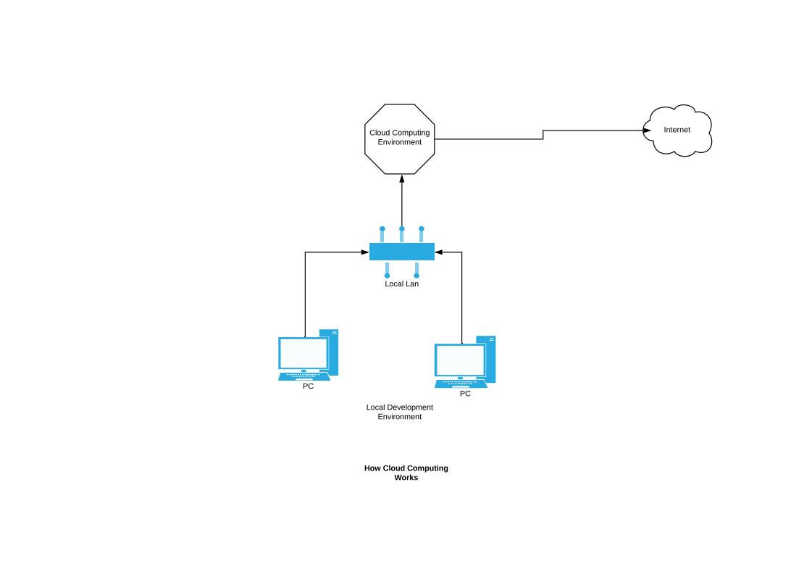
Cloud Computing

Slide 32
Cloud Computing
Now that we know what cloud computing is, there are several different vendors that offer these services. They are:
Amazon Web Services (AWS)
Microsoft Azure (AZURE)
Google Cloud Platform (GCP)
And a few others.
In this course we will be focusing only on AWS.

Slide 33
Cloud Computing
These are not the only platforms. There are many more, but we’re only going to talk a bit about three, as they are the main ones.
The others are worthy of note, however.
1) IBM Cloud
https://www.youtube.com/watch?v=VXqbRNwXC2A
2) Oracle Cloud
https://www.youtube.com/watch?v=K_M9HZShQ50
3) VMWare
https://www.youtube.com/watch?v=fJktrxFhOxk

Slide 34
Cloud Computing
There are 3 factors to consider when choosing a cloud provider.
1) Availability Zones
- isolated locations that provide high availability for their customers
2) Market Share
- how much of the cloud computing customer base is the provider serving. This is important to estimate how stable the platform is as well as how much experience they have delivering services.
3) Services
- What kind of services do these platforms provide

Slide 35
Cloud Computing
Comparing the three main Cloud Services:
Amazon Web Services
1) It is the oldest and most trusted player in the market, launching in 2006.
2) 55 availability zones
3) 200+ Services

Slide 36
Cloud Computing
Microsoft Azure
1) Established in 2010
2) 44 availability zones
3) 100+ Services

Slide 37
Cloud Computing
Google Cloud Platform
1) Launched in 2011
2) 18 Availability Zones
3) 60+ Services

Slide 38
Cloud Computing
Additional Resources for Comparing Cloud Services:
1) https://www.youtube.com/watch?v=nrqmYvjHHJg
2) https://www.youtube.com/watch?v=n24OBVGHufQ

Slide 39
Cloud Computing
Resources for Amazon Web Services
https://www.youtube.com/playlist?list=PL9ooVrP1hQOFUm7TmkH1zk5xy75GAxV44
https://www.youtube.com/watch?v=RLd_XTyt-w8
https://www.youtube.com/watch?v=Z3SYDTMP3ME
Resources for Microsoft Azure:
https://www.youtube.com/watch?v=tDuruX7XSac&t=15s
Resources for Google Cloud:
https://www.youtube.com/playlist?list=PL9ooVrP1hQOFUm7TmkH1zk5xy75GAxV44

Slide 40
Cloud Computing
Storage
AWS has a storage solution that replaces common hard drives in the data centre.
Instead of buying new hardware, we can use the service S3 to take care of our storage needs.

Slide 41
Cloud Computing
S3
S3 consists of Objects and Buckets.
An object is similar to what we call files.
A bucket is similar to what we call hard drives.
Objects can be any size between 0 bytes and 5 Terabytes.
Buckets can be of unlimited size.

Slide 42
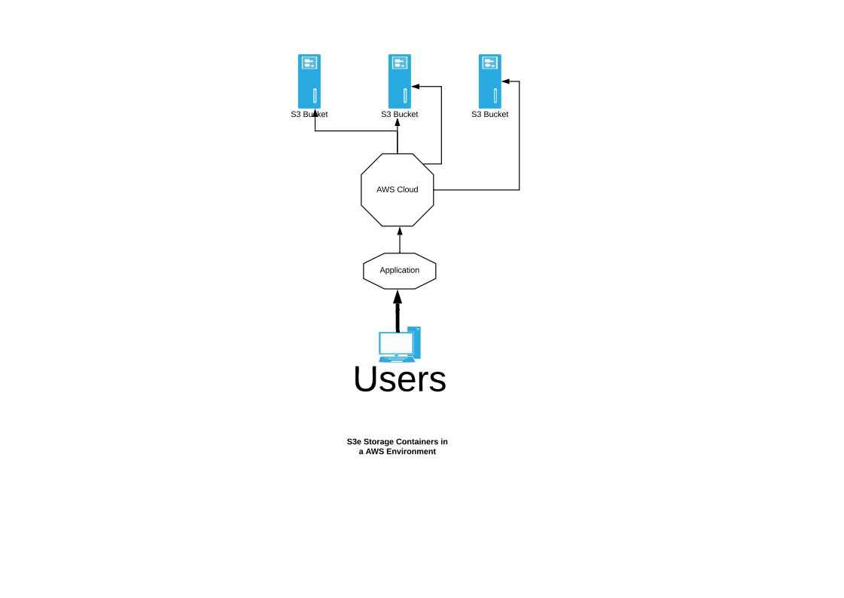
Cloud Computing

Slide 43
Cloud Computing
Security
Seeing that your data is now being stored in the cloud, security becomes even more important. You have to make sure that files being transferred to the cloud are encrypted, as well as data stored at rest in the cloud is encrypted.
Access to data on the server is configured with access (who can access these files) as well as encryption.

Slide 44
Cloud Computing
Access Lists and Bucket Policies
Access control lists and bucket policies set who can access which data on which bucket.
Demo creating an access list and uploading a file with these policies.

Slide 45
Cloud Computing
Bucket Policies
1) Click bucket
2) go to permissions
3) select bucket-policies
4) click generate – policy
Demo how to set a policy up by preventing all users from accessing the bucket.
5) Click generate json
6) Cut and paste that json
7) Put into the bucket policy
8) Click save
9) try uploading a new file to our bucket and it should error out

Slide 46
Cloud Computing
Encryption
Encryption comes in two forms:
Transfer Encryption:
Data being transferred to S3 is encrypted with either SSL or
TLS.
At rest Encryption:
Data sitting on your bucket is encrypted with one of 4
different encryption options.
Demo configuring both types of encryption and show that the files are still being able to be read from the browser.

Slide 47
Cloud Computing
Cross Regional Replication (CRR)
The S3 service allows you to store data across different buckets in different regions. This provides data replication and makes sure your data never goes away.
Demo setting up CRR

Slide 48
Cloud Computing
Versioning
Versioning is a very nice feature that will cost you a fortune to do on traditional data centre.
If you enable versioning on your data, every file you store in your bucket will be saved with different version numbers. This means, if you ever have to go back to a previous version, you can do it easily.
Demo setting up a VC on a bucket and delete one version of the file.

Slide 49
Cloud Computing
Transfer Acceleration
One issue with cloud storage has been the long transfer time between uploading data to your cloud storage.
Transfer Acceleration allows you to upload to a network location close to you, and then use the amazon backbone to transfer to your bucket.

Slide 50
Cloud Computing
Life Cycle Management
Life Cycle Management is also a very handy feature of cloud data storage.
Once set up, it allows you to set policies on a file (or group of files) to move files based on a specific age limit to another (cheaper) tier of storage. This means, once you don’t need the files anymore, you don’t have to pay a higher price for that tier.
Demo setting up life cycle management

Slide 51
Cloud Computing
MFA
MFA Delete is a feature that lets you ensure that it’s you that’s deleting a file on your bucket. Once set up, you will require a key to be passed into your delete function so that you can verify who it is that’s deleting.

Slide 52
Cloud Computing
S3 Demo
1) Create a Bucket
2) Upload a file
3) Set Permissions on that File

Slide 53
Cloud Computing
AWS S3 Resources:
https://www.youtube.com/watch?v=L3dYocCSU-E&t=13s

Slide 54
Cloud Computing
ASSIGNMENT
1) Create two buckets
2) Setup version control on both
3) Enable CCR on both
4) Create an bucket policy that will prevent a user from
uploading a file into that bucket.
5) Verify that you can’t upload a file.
6) Setup a Lifecycle Management Policy that moves files
older than 30 days into the cheapest tier for storage.
7) Setup transit security using TLS
8) Turn on at rest security with the SSE-C default

Slide 55
Cloud Computing
AWS S3 Command Line Interface
Up until now, we’ve been using the AWS console dash board to do all of our tasks.
There is, however, another option that is used once you are more familiar with cloud services.
This method is called the AWS CLI.
You can use this cli for everything you use the dashboard for.
Ie) Copying data to the aws bucket
aws s3 cp s3://your-bucket/your-folder/d.jpg ~/path

Slide 56
Cloud Computing
Setting up Cross Region Replication
1) We need a new bucket in a new region
Now we have 2 buckets
Versioning turned on
Setup CRR
1) Click s3 storage
2) click bucket
3) click management
4) click replication
5) enter destination bucket

Slide 57
Cloud Computing
Virtual Private Cloud (VPC)
Your own data centre

Slide 58
FINAL Project
Testing Out Our Knowledge
Now that we have a solid understanding of DevOps we are going to take our knowledge and put it into practice.
The Assignment
1) Configure another Ubuntu 19.04 virtual machine
2) Install our tools (docker / python / git / jenkins) on that machine
3) Setup Jenkins to run in a container on that VM
4) Use Ansible to create an EC2 instance on AWS
5) Create an application directory for our python application
6) Put our python directory under version control
7) Configure python to push that application up to the EC2
instance on AWS.
8) Verify our application is working on our EC2 Instance.

Slide 59
THE END
QUESTIONS?

